Slide 1
Making of the Modern Mind

Slide 2
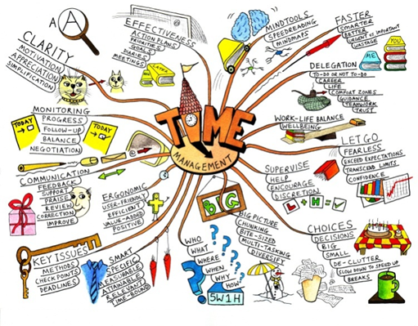
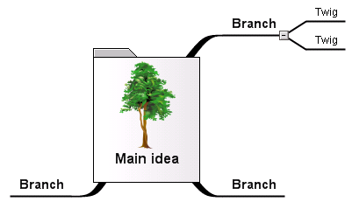
This course integrates:
Philosophy of Mind
Humanities
Cognitive Science/Psychology
Critical Thinking
A way to stimulate your mind
Opens a flow of creative thinking
A way to see how things connect
Whole braining thinking that identifies and solves problems
Brainstorm
Visualize
Think in a new way

Slide 3
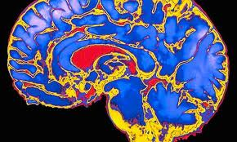
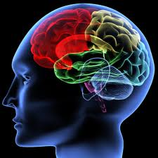
“You have been entrusted with the care and feeding of the most extraordinary and complex creation in the universe.
Home to your mind and personality, your brain houses your cherished memories and future hopes.
It orchestrates the symphony of consciousness that gives you purpose and passion, motion and emotion.”
But what do you really know about it ?
(Quote from Franklin Institute for Science Learning)
Notes:
http://www.quantumconsciousness.org/presentations/whatisconsciousness.html

Slide 4
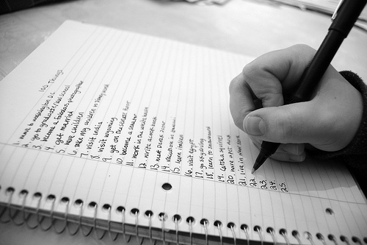
Make a list:
How many uses can you think of for a chair?

Slide 5
individuation
http://psychology.about.com/od/sensationandperception/ig/Optical-Illusions/spinning-dancer-illusion.htm
http://www.heraldsun.com.au/news/right-brain-v-left-brain/story-e6frf7jo-1111114603615

Slide 6
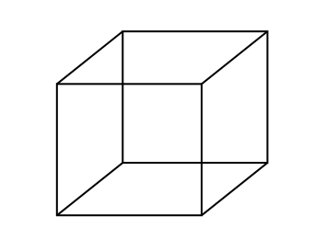
Bistable Perception /Multistable Perception
Rubin face-vase illusion
Necker Cube
Both images are bistable perceptions, in which the brain spontaneously
switches between two interpretations of the same ambiguous stimulus

Slide 7
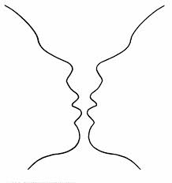
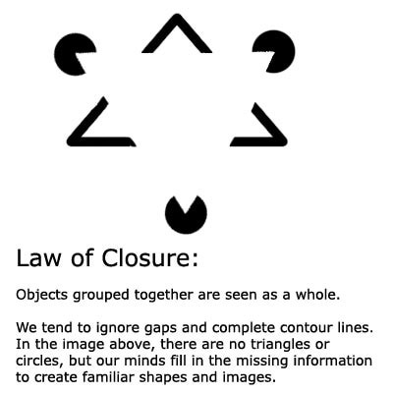
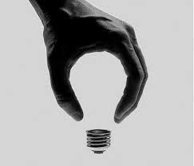
Gestalt Laws of Perceptual Organization
Our brains ignore contradictory information and fill gaps in with information.
Confabulation: (Psychology ) To fill gaps in one's memory with fabrications that you believes to be facts.

Slide 8
THE MISSING HORIZON Individual Perception & perspective

Slide 9
POP-PSYCHOLOGY and myths
We only use 10% of our brain
That we’re left brain or right brain thinkers

Slide 10
Priming …And the cognitive dissonance that follows…
How did the article prime us to see her spin one way or the other?
Notes:
In two weeks we’ll talk about priming- and how you can prime someone.
What Cognitive dissonance is, including Milgram Experiment, and the discomfort of the ‘teachers” as an example

Slide 11
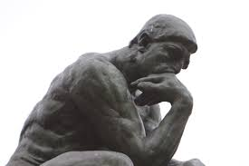
The left hand doesn’t know what the right hand is doing?
Decides there is a final stage that pulls information together
Wins a Nobel Prize 1981
Note that the theory of Left Brain Narrative is similar to Confabulation
http://www.medclip.com/index.php?page=videos&section=view&vid_id=103271

Slide 12
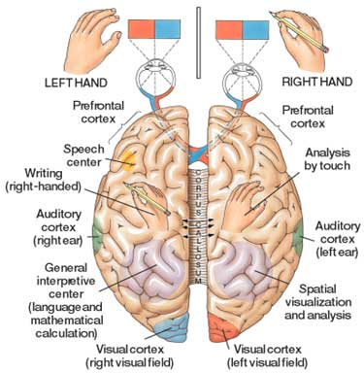

Slide 13
The Split-Brain (Gazzaniga & Sperry at Cal-Tech)
Wins a Nobel Prize 1981
https://www.youtube.com/watch?v=lfGwsAdS9Dc
https://www.youtube.com/watch?v=ZMLzP1VCANo

Slide 14
Split-Brains
Dr. Gazzaniga:
“The brain isn't like a computer, with specific sections of hardware charged with specific tasks. It's more like a network of computers connected by very big, busy broadband cables. The connectivity between active brain regions is turning out to be just as important, if not more so, than the operation of the distinct parts.”
Experiments have shown:
It was commonly believed that the left brain is analytic and the right brain is artistic but fMRIs shows that specialized tasks engage networks across the entire brain
That each half of the brain can function independently
That while each brain can act independently, with communication they can work together
That each half of the brain can compensate for the other half
Dr. Gazzaniga talks about the story we create:
https://www.youtube.com/watch?v=ZMLzP1VCANo

Slide 15
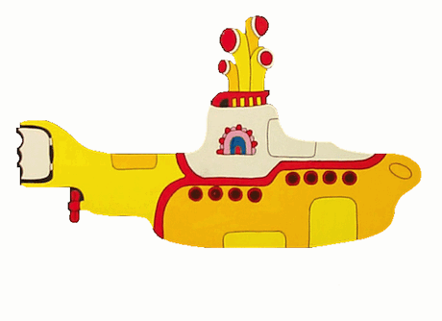
Dr. Michael S. Gazzaniga: Split brain research
Hmmm. Who’s driving the submarine?
https://www.youtube.com/watch?v=laRyswIO_-g

Slide 16
Critical Thinking Questions:
Remember the chair and how to use it?
How creative were you?
Do you think the test can assess creativity?
PRIMING: If I had included an image of a chair along with the question, do you think your answers would have changed? How? Why?
GROUP THEORY:
Were large groups more creative than the smaller groups- did you
think being in a group was good- / or were individuals more creative?
Did individuals feel marginalized, more pressure, or did you think there was there more freedom to think?
Did urge to be competitive- a me/us vs them kind of thinking?

Slide 17
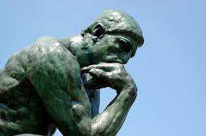
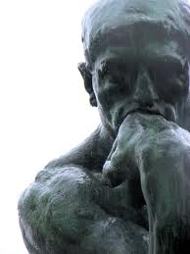
Q: Why Study Philosophy of the Mind?
A: The Brain is the Final Frontier
There is so much left to discover
and so much we don’t know
Notes:
MOVE THIS LATER- CONNECT TO MEMORY ACQUISITION…
REPLACE THIS HERE W/ TALK ON 1) DESCARTES SHIP 2) LEGAL DEFENSE 3) EDUCATION TABULA ROSA 4) GOVERNMENT, RIGHTS AND EQUALITY (ETHICS) 5) medicine- cures

Slide 18
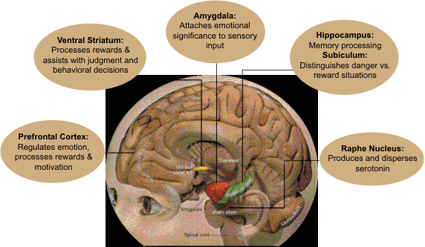
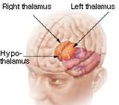
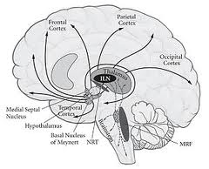
Q: What is Philosophy of Mind?
A: Generally it includes
study of the mind, mental events and functions
relation of the mind to the brain and the body
properties of the mind
consciousness
Notes:
A:
It generally includes study of the mind, mental events
and functions, properties of the mind, consciousness
and the relation of the mind to the brain and the body

Slide 19
Three Approaches | Three Perspectives:
1.) Relation of mind to brain and body
Is your mind something distinct from your body, or
do ordinary physiological processes produce minds?
2.) Applied Engineering
3.) The Universe and laws of physics

Slide 20
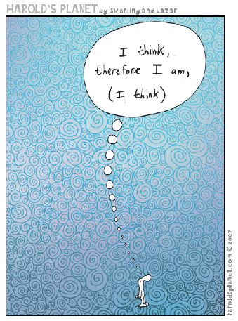
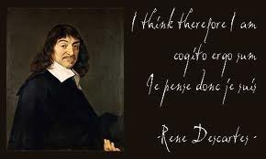
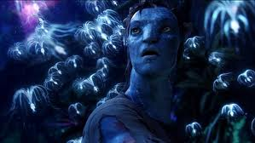
The mind-body problem
Q:
How does the mind relate to physicality- the brain & nervous system ?

Slide 21
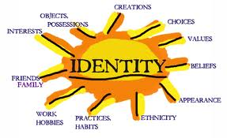
Mind Body problem
Dualism:
holds that body and mind are separate substances
Property Dualism
1. Physical properties
Consciousness = neurobiology
2. Mental Properties
Material evolves properties depending on how its used or activated
Substance Dualism
1. Mind is material substance
2. Body is material, but it can’t think
Cartesian Dualism: argues that there is a two-way interaction between mental and physical substances
How can the mind, which is immaterial, cause anything?
How can something immaterial, react with material?

Slide 22
What is the Connection between Mind, Matter and Space? (the hard problem of consciousness)
The mind is affected by matter.
The mind can move matter in space.
The mind produces brain waves in space when thinking.
Can you think of examples?
What does mind over matter mean?
What does it mean when we say: Are you out of your mind?
Notes:
On the Connection between Mind, Matter and Space.
The Mind can Move Matter in Space. Walking around, eating, breathing, typing are all examples of this.
This is why we have evolved hands and feet, arms and legs - so our mind can move our body around. T
The motion of matter and mind in space are one connected thing - the wave motion of space.
The Mind is Affected by Drugs (Matter). Mind is affected by Food
It is well known that certain drugs, which are made of matter, can have profound effects upon the mind.
Again this clearly confirms the connection between mind and matter, that matter has a profound effect on the functioning of the mind.
The Mind Produces Brain Waves in Space when Thinking.
Again, this is well known and they can now use this knowledge to build machines that allow us to do physical things to external objects (e.g. turn lights on) merely by thinking.
The wave structure of matter explains why these brain waves exist, because matter and mind are formed from wave motions of space.

Slide 23
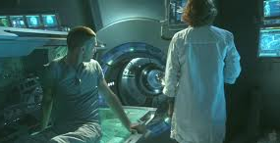
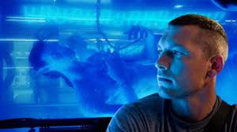
Philosophy of Mind: from the Perspective of Applied Engineering
http://www.thefreedictionary.com/embodiment
http://www.youtube.com/user/mindsignonline
EMBODIMENT
AVATAR ?
ROBOTICS
Embedded Chips
Integrated prosthetics
The question of how biological & physical processes
inter-relate with mental processes
ETHICS related to artificial intelligence and medical treatments
Notes:
relationship that exists between minds, or mental processes, and bodily states or processes

Slide 24
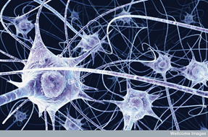
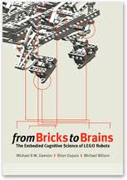
Embodied cognition
The body influences the mind
Senses
Stimuli
Perception
Environment
Emotions influence the mind
Cognition is part and parcel to the environment- the situation we’re in. Decoupled from that, cognition is a set of skills and abilities which include: perception and visualization of imagery, working memory, episodic memory, implicit memory and the ability to solve problems.
WOW! A robot with embodied cognition-

Slide 25
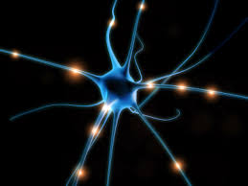
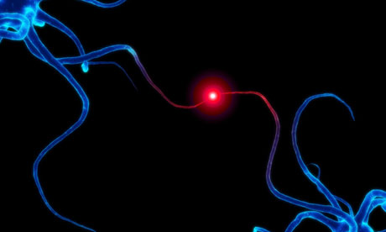
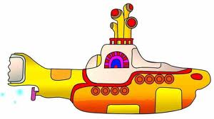
Philosophy of Mind: law of physics perspective: Is the brain connected to the universe at a quantum level?
Research in 2013 discovered quantum vibrations in neuron microtubules
microtubules are part of the cell scaffolding
protein polymers inside brain neurons
Both govern neuronal and synaptic function
& connect brain processes to self-organizing processes
Theory of Orchestrated Objective Reductions is highly contested
Notes:
The restatement of the theory has produced a flurry of criticism in the journal where it was published, Physics of Life Reviews, but the authors maintain that their theory suggests…
“…conscious experience is intrinsically connected to the fine-scale structure of space–time geometry, and that consciousness could be deeply related to the operation of the laws of the universe.”
Orchestrated objective reduction (Orch-OR) is a controversial 20-year-old theory of consciousness conceptualized by the theoretical physicist Sir Roger Penrose and anesthesiologist Stuart Hameroff, which claims that consciousness derives from deeper level, finer scale quantum activities inside the cells, most prevalent in the brain's neurons. It combines approaches from the radically different angles of molecular biology, neuroscience, quantum physics, pharmacology, philosophy, quantum information theory, and aspects of quantum gravity.^{[1]}

Slide 26
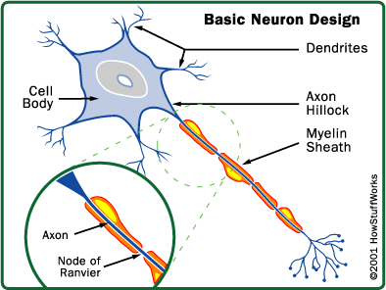
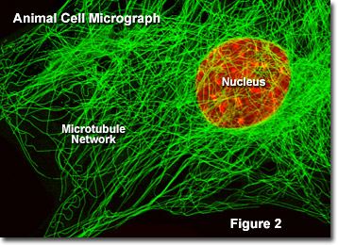
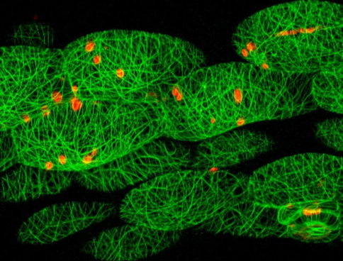
What is consciousness?
“Even the best computer doesn't know it exists.”
Agree?
nucleus
Axon terminal

Slide 27
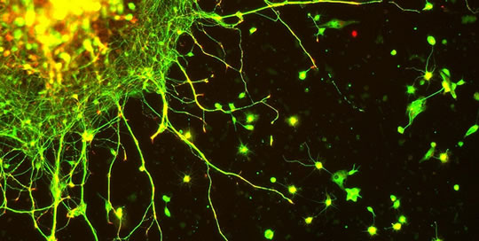
If consciousness is linked to the laws of the universe……
“…conscious experience is intrinsically connected to the fine-scale structure of space–time geometry, and that consciousness could be deeply related to the operation of the laws of the universe.”
Notes:
The restatement of the theory has produced a flurry of criticism in the journal where it was published, Physics of Life Reviews, but the authors maintain that their theory suggests…
“…conscious experience is intrinsically connected to the fine-scale structure of space–time geometry, and that consciousness could be deeply related to the operation of the laws of the universe.”

Slide 28
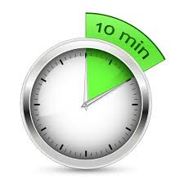

Slide 29
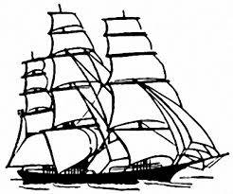
Pirates and Dualism

Slide 30
Make some notes, share with your neighbors:
What is mind? Does it have parts? Is mind
different from the brain?

Slide 31
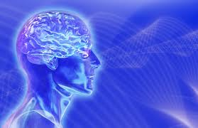
What is the Mind?
How does the mind relate to the brain, and body?
What is a mind like?
What are the properties or characteristics?
Do minds have parts?
If so, how would you describe them?
Is mind different from the brain?
Where does it start, where does it end?

Slide 32
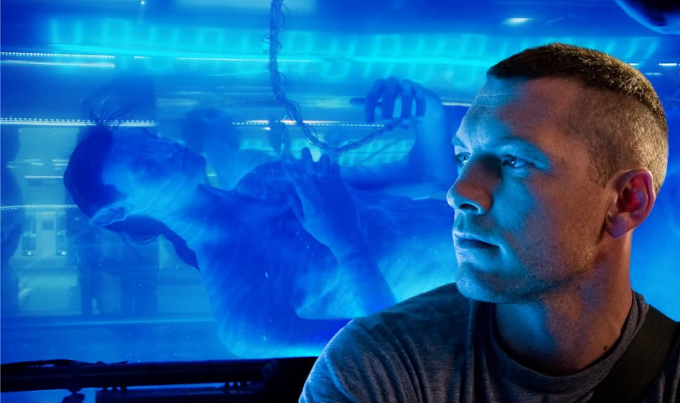
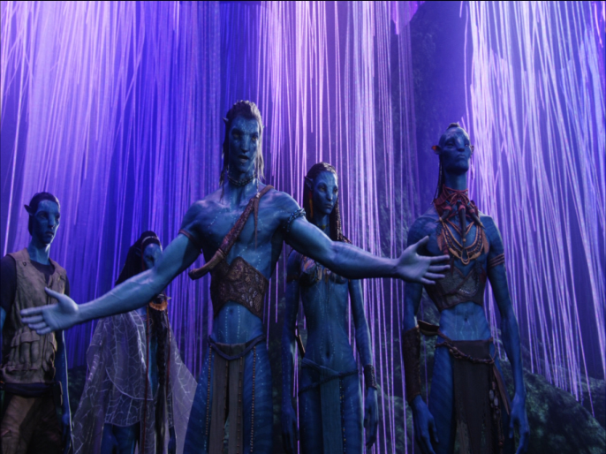
Who is the real Jake Sully?
Critical Thinking Questions:
is the mind part of the brain and body?
If they are distinct, how do they interact?
Does the answer change the way we learn, engineer robots or design tech? Should robots have the same rights as humans?
In what ways does this change or affect identity and the idea of who you are and how you got to be that way?
How vast is the mind?
Is there a collective mind?

Slide 33
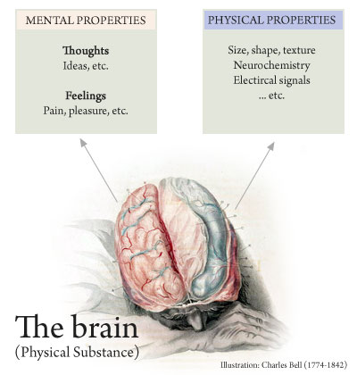
properties
Property is the attribute of something, or its quality
Questions:
If the quality is accidental is it still a property?
Does it have to be perceived to exist as a property?
Is the mind an intrinsic property, or is it extrinsic?
Examples??

Slide 34
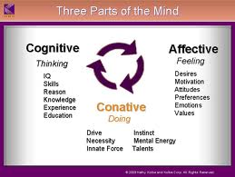
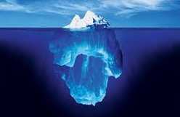
Does the mind have Parts ?
Conative
Cognitive
Affective
Implicit Memory
Explicit Memory

Slide 35
Behavior & IDENTITY
If Knowledge is learned…
And Behavior is learned..
What about identity?
Ethics

Slide 36
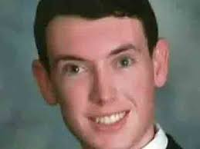
IS BEHAVIOR LEARNED? ETHICS, IDENTITY & LAW
Who is James Holmes?
Same Person?
Guilty, or not guilty by insanity?
Is he responsible for his actions? Why?
https://www.youtube.com/watch?v=O0kuM6vv6u4

Slide 37
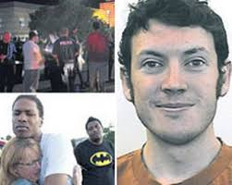
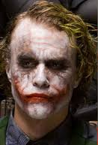
Ethics
Guilty, innocent or guilty by insanity?
He was diagnosed with Schizophrenia… is he responsible for his actions?

Slide 38
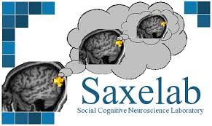
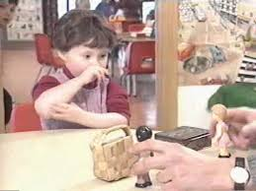
Theory of Mind
Rebecca Saxe: http://www.ted.com/talks/rebecca_saxe_how_brains_make_moral_judgments.html

Slide 39
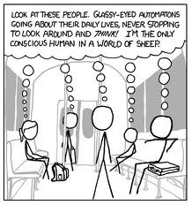
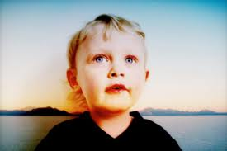
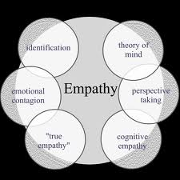
The Problem of Other Minds
http://www.youtube.com/user/mindsignonline
http://www.ted.com/talks/rebecca_saxe_how_brains_make_moral_judgments.html
Notes:
Theory of mind is a cognitive skill where children starting at age 4 begin to understand that people can be motivated by beliefs regardless of whether those beliefs are true or false. Using more mentalistic language helps children develop a theory of mind because of pragmatic features of the language, such as the enunciation of various perspectives (Harris,de Rosenay, & Pons, 2005). Using terms like think and know can help in development of theory of mind because when children themselves attribute false beliefs to others, they end up using similar linguistic constructions.
When mothers talk to their children about how others can have false beliefs, they also end up expressing various emotions that come by the virtue of having those beliefs (Harris, de Rosenay, & Pons, 2005). This is why use of mental terms in language not only helps in understanding of false beliefs but also understanding of how people can be affected by these false beliefs.

Slide 40
Blank slate
Tabula Rasa
Notes:
Knowledge comes from experience and perception
Freud believed we are born Tabula Rasa, we don't have free will and our character is influenced by our upbringing
Locke: we write our own soul

Slide 41
Behaviorism
Psychology should be seen as a science.
Theories need to be supported by empirical data obtained through careful and controlled observation and measurement of behavior.
Is primarily concerned with observable behavior, not internal events like thinking and emotion. Observable (i.e. external) behavior can be objectively and scientifically measured. Internal events, such as thinking should be explained through behavioral terms (or eliminated altogether)
People have no free will – a person’s environment determines their behavior
When born our mind is 'tabula rasa' (a blank slate)
There is little difference between the learning that takes place in humans and that in other animals. Therefore research can be carried out on animals as well as humans.
Behavior is the result of stimulus – response (all behavior, no matter how complex, can be reduced to a simple stimulus – response association)
All behavior is learned from the environment.
We learn new behavior through classical or operant conditioning.

Slide 42
Embodied cognition
The body influences the mind
Senses
Stimuli
Perception
Environment
Emotions influence the mind
Cognition is part and parcel to the environment- the situation we’re in. Decoupled from that, cognition is a set of skills and abilities which include: perception and visualization of imagery, working memory, episodic memory, implicit memory and the ability to solve problems.
WOW! A robot with embodied cognition-

Slide 43
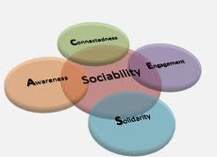
Behaviorism We’re born a blank state
Experience and our environment shape who we are
Classical Conditioning
Skinner studies
Social conditioning
Social skills = larger brain
The larger the community group of a primate species,
the larger that species’ brain relative to the body
Human sociability may account for a particularly large brain

Slide 44
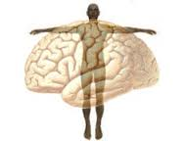
Behaviorism Shaping behavior
3 perspectives: relationship of mind, brain and body
applied engineering
universe and laws of physics
Q: can a robot learn to be a better robot?
What about people:
Morality and responsibility
Judgment and decisions-> Do we have free will?
Q: What about hypnosis or conditioning? Can we be made evil ?
Skinner, free will: https://www.youtube.com/watch?v=rTND_HGrP08
X More Skinner experiments videos: http://www.youtube.com/channel/HCMAAVrGOuFnc
Skinner experiments on conditioning, & ‘superstitious belief’ http://www.youtube.com/watch?v=X6zS7v9nSpo
Notes:
The opposite of this: Pinker’s
And hillman’s Acorn Theory

Slide 45
Epiphenomenalism
If mental events are caused by a physical event, if that is so,
the mental event is not the same as the event
(just as contrails are caused by the plane but are not the plane
A dualist theory that decision making is not a mental event
Notes:
One of the side effects of this theory is that it implies that decision making is not a mental event.
what most people miss is the fact that mental events are said to be caused by physical events. This being so, mental events cannot be identical with events, just as smoke cannot be identical with the fire which causes it.
The question becomes: how are decisions made? Is decision making a bodily process? If so, what difference is there between epiphenomenalism and certain forms of materialism?

Slide 46
Epiphenomenalism
That leads to the premise that decisions are not a mental event.
How do we make decisions?
Is a decision a bodily process?
Notes:
One of the side effects of this theory is that it implies that decision making is not a mental event.
what most people miss is the fact that mental events are said to be caused by physical events. This being so, mental events cannot be identical with events, just as smoke cannot be identical with the fire which causes it.
The question becomes: how are decisions made? Is decision making a bodily process? If so, what difference is there between epiphenomenalism and certain forms of materialism?

Slide 47
Classical Conditioning
A form of learning
Creates a change in behavior and the change results in learning.
from the view of a behaviorist,
How do you think conditioning can effect learning and build memory ? If so, how? What about social conditioning?
Big Bang Theory: https://www.youtube.com/watch?v=qy_mIEnnlF4

Slide 48
MODELING
To learn by observing what someone else does.
When a person learns by imitation without any specific verbal directions or instruction

Slide 49
Bobo Doll, a study of aggression Alberta Bandura, 1961 Stanford University, Nursery School, 72 children from the age of 3 to 6. (Average age: 4.4)
Most people at the time believed
that watching violence would reduce
aggression. It would purge us of
aggression. It’s cathartic.
Hypothesis: social behaviors (i.e. aggression) can be acquired by observation and imitation.
experiment narrated by Albert Bandura : http://www.youtube.com/watch?v=Z0iWpSNu3NU (5 minute )
BBC commentary which brings in the question if children copy behavior from what they see on TV; http://www.youtube.com/watch?v=zerCK0lRjp8

Slide 50
Marshmallow test
http://www.cnn.com/2014/12/22/us/marshmallow-test/

Slide 51
Making of the modern mind

Slide 52
How do we learn? Idea Framing and Metaphor
Schema
Systems
Frames
Emotion and memory:
We don’t just remember something; our memories are colored with emotion. All of our experiences are influenced by previous experiences through complex loops in the brain's limbic system.
Also referred to as Embodied Learning
George Lakoff
http://www.youtube.co m/watch?v=S_CWBjyIERY

Slide 53
Mirror Neurons a fascinating new area in the early stages of study
Mirror neurons do not mean these neurons have a Theory of Mind/empathy
One theory is mirror neurons merely facilitate learning through imitation
The TPJ is not part of the mirror neuron network (Rebecca Saxe research)
Why do we cry at the movies?
See Monkey, See Monkey Do
http://www.pbs.org/wgbh/nova/education/body/mirror-neurons.html
Mirror Neurons and Intention
http://www.youtube.com/watch?v=Tq1-ZxV9Dc4
>>> Did he prime me to want water, or were my mirror neurons imitating him?
Podcasters, Stuff You Should Know explain mirror neurons:
http://science.discovery.com/tv-shows/stuff-you-should-know/videos/stuff-you-should-know-mirror-neurons.htm

Slide 54
False belief test & Mirror Neurons
People with a fully developed TPJ will respond their cheese sandwich is where they left it
Theory of Mind shows that a person can guess the
mind of another person by understanding how
he would see or view the situation- even be fooled by it
and have a false belief
Monkeys have mirror neurons, but it hasn’t been shown that they have Theory of Mind, therefore the Mirror Neuron research is inconclusive regarding empathy, or that Mirror Neurons help develop empathy or Theory of Mind
Notes:
http://medicalxpress.com/news/2015-05-microsoft-human-attention-span-lags.html
In analyzing the data obtained, the researchers found that the average attention span for the respondents and volunteers was just eight seconds, down from twelve back in 2000, and one second shorter than the average goldfish. They also found that using digital devices has caused an improvement in multi-tasking skills.

Slide 55
Guilty or not guilty
The poison hypothesis
She puts what she believes is sugar into her friends coffee
She puts what she believes is poison into her friends coffee, but it’s sugar
She puts poison into the coffee, thinking its sugar and her friend dies
She knowingly puts poison into her coffee
Notes:
Grace and her co-worker are taking a tour of a chemical factory. ... The container, however, has been mislabeled “sugar”, so Grace ... ing to poison someone) as morally worse than an accidental harm
One of these involves Grace and her friend having a cup of coffee during a tour of a chemical plant. In one version of it, she puts what she rightly believes to be sugar into her friend’s drink; in another, she puts what she believes to be poison, but what is actually sugar, into the drink; in the third variation, Grace puts poison into the cup, thinking it is sugar, and her friend dies; and in the final variation, she knowingly puts poison into the drink.
These scenarios differ in the beliefs underlying Grace’s actions and in their outcome. Most of us would agree that she acts “wrongly” by poisoning her friend in the fourth variation of the scenario. She was also wrong in the second, because although the outcome was neutral, she attempted to cause harm to her friend. On the other hand, most would agree that she was not wrong in the unfortunate scenario in which she unwittingly poisoned her friend. Although her act was guilty, her mind was not – it was not her intention to kill.

Slide 56
MARSHMALLOW TEST
TEMPTATION
WILL POWER
DELAYED GRATIFICATION
RESTRAINT
PATIENCE
LONG TERM GOALS
GRIT
http://www.cnn.com/2014/12/22/us/marshmallow-test/

Slide 57
The attention span of a goldfish
Who has a longer attention span?
A tech-savvy person or a goldfish?
Notes:
http://medicalxpress.com/news/2015-05-microsoft-human-attention-span-lags.html
In analyzing the data obtained, the researchers found that the average attention span for the respondents and volunteers was just eight seconds, down from twelve back in 2000, and one second shorter than the average goldfish. They also found that using digital devices has caused an improvement in multi-tasking skills.

Slide 58
Attention & CHANGE BLINDNESS
This is a test
https://www.youtube.com/watch?v=Qghh2Zsh3CY

Slide 59
Attention
Attention
Focusing
General resources
Specificity of resources
I didn’t hear you calling. I can’t listen
to everybody who yells at me.
William James
“Attention is the taking possession of the mind, in clear and vivid form… It implies withdrawal from some things in order to deal effectively with others."
Quirk Video: https://www.youtube.com/watch?v=voAntzB7EwE

Slide 60
ATTENTION
Sustained
Alternating/shifting
Selective
Ability to focus
like a highlighter helps us focus on certain
things and tune out others
Limited capacity
Multi-tasking
Part of our biology and helps us survive

Slide 61
Attention
Your attention, please! (It can relocate)
Pay attention! (Attention is a resource)
Hold your attention
Bring it to your attention (it’s personal)
Direct your attention (it’s a choice/voluntary)
It grabbed my attention (It can be involuntary)
Give me your undivided attention (It can be divided)
I wasn’t paying attention (it can be lost or squandered)
Attention deficit disorder (we can have insufficient attention)
Center of Attention (it can be combined with others)
Selected Attention vs Divided Attention

Slide 62
This is a test
University of Chicago Video : https://www.youtube.com/watch?v=IGQmdoK_ZfY

Slide 63
Identity & Shifting identity
CRITICAL THINKING QUESTION:
How does attention play a role in identity?

Slide 64
CRITICAL THINKING QUESTION:
Is there a connection between
Attention & Identity?

Slide 65
NEURONS: The Location of Memory
Memories are Physical: Not conceptual
A memory (engrams) can’t be erased
A gene controls the formation of memories
MIT named the gene Npas4
Neurons in the Hippocampus
Using Optogenetics
(light is used to control neurons)
Without the gene, we cannot form memories
Center for Neural Circuit Genetics at the Picower Institute for Learning and Memory at MIT

Slide 66
Memory
3 systems:
Short term- active memory
7 things
7 seconds – 30 seconds
Sensory- from senses and experiences
Long term- is stored memory
About 86 billion neurons in a brain
Explicit (declarative) Conscious
Implicit (procedural) Subconscious

Slide 67
Memory
Working Memory
Central Executive, Prefrontal lateral cortex (PFC)
WM includes Short Term Memory
But not all memory goes
to long term Memory
Some memories are never in dreams- can you guess why??

Slide 68
MEMORY
Stages of memory
Encoding
Storage
Retrieval
Kinds of Memory
Short-term memory
Working memory
Long-term memory (Explicit and implicit)
Systems for Consolidation
Synaptic consolidation (within minutes)
Systems consolidation (while we’re sleeping)
Updating and Reconsolidation (weeks, even years later)

Slide 69
90 Second Memory/25 words
Nine Swap Cell Ring Trust
Plugs Lamp Apple Table Sway
Army Bank Fire Hold Worm
Clock Horse Color Baby Sword
Desk Hold Find Bird Rock

Slide 70
90 Second Memory/ 25 words
Horse Cat Dog Fish Bird
Orange Yellow Blue Green Black
Table Chair Desk Bookcase Bed
Teacher School Student Homework Class
Apple Banana Kiwi Grape Mango

Slide 71
Limit of “cognitive budget” and mental resources?
A person can perform concurrent tasks only if the sum of the tasks’ demands is within the cognitive budget
Chunking
7+-

Slide 72
Change Blindness A person can be unaware of something that is right in front of their eyes
there is simply too much information for
my brain to fully process and be aware
of every single thing that happens in my
immediate environment.
In many cases, big shifts can happen in your visual field and you are never even aware of these changes.
Psychologists refer to this as
change blindness.
Whodunit: https://www.youtube.com/watch?v=S9WC-vWCkkU

Slide 73
Change Blindness Why are we blind to change? If we miss the elephant in the room- What else do we miss?
Looking isn’t the same as seeing. You have to focus attention to be aware.
Dan Simons and the gorilla narrate about the study
http://www.youtube.com/watch?v=UtKt8YF7dgQ

Slide 74
Priming
A process through which one input or cue prepares a person for an upcoming input or cue
Implicit memory (unconscious)

Slide 75
priming is
Unconscious and implicit
Schema
Bias
Generalization, simplification
Conditioning
But is it
Automaticity
Causal
If we act automatically or unconsciously, how does that equate to a lack of free will?

Slide 76
How does the Chicago Experiment prime the participants to Miss the “Gorilla in the Room”?

Slide 78
John Bargh
Dual Processing | Implicit & Explicit | Priming
John Bargh https://www.youtube.com/watch?v=vI0fFEffDd8
Malcom Gladwell controversial interview: https://www.youtube.com/watch?v=OY0WFdk44pc
A small sample to recreate Bargh’s study: https://www.youtube.com/watch?v=5g4_v4JStOU

Slide 79
John Bargh:
Hot
Cold
Hot and cold?
http://www.youtube.com/watch?v=efOF60dv5KQ

Slide 80
Automaticity

Slide 81
Power of suggestion
What we expect influences our behavior, for better or worse
https://www.youtube.com/watch?v=Wu1qL0lxp5Y

Slide 82
TWO SYSTEMS:
Daniel Kahneman | Psychologist | Nobel in Economics
Two Systems
System One
System Two
>> A little experiment in how your mind works:
Q: If a bat and a ball cost $1.10
and the bat is $1.00 more than the ball,
how much does the ball cost?
Notes:
MOVE THIS LATER- CONNECT TO MEMORY ACQUISITION…
REPLACE THIS HERE W/ TALK ON 1) DESCARTES SHIP 2) LEGAL DEFENSE 3) EDUCATION TABULA ROSA

Slide 83
Dual Processing
Thinking Fast, Thinking Slow
System One, System Two
Implicit, Explicit
System One | Implicit
Fast, quick, efficient, automatic, unconscious
System Two | Explicit
Laborious, slow, analytic, conscious working memory

Slide 84
For more information | class one:
Dr. Gazziniga: Split brain research
http://www.informationphilosopher.com/solutions/scientists/gazzaniga/
Dr. Gazzinga and Alan Alda -Brains work independently
https://www.youtube.com/watch?v=lfGwsAdS9Dc
The Interpreter Within: The Glue of Conscious Experience
http://www.dana.org/Cerebrum/Default.aspx?id=39343
Dr. Ganziga, split-brain research
http://www.nytimes.com/2011/11/01/science/telling-the-story-of-the-brains-cacophony-of-competing-voices.html?pagewanted=all
Video: http://www.nytimes.com/video/science/100000001142409/michael-gazzaniga.html
http://bigthink.com/users/michaelgazzaniga
Legal Responsibility
Center for Law, Brain and Behavior http://clbb.mgh.harvard.edu/criminal-responsibility/
Coma Patients: http://www.medpagetoday.com/Neurology/HeadTrauma/40947
See Monkey, See monkey Do: Mirror Neuron Research
http://www.psychologicalscience.org/index.php/news/releases/monkey-see-monkey-do-the-role-of-mirror-neurons-in-human-behavior.html
See Monkey, See Monkey Do
http://www.pbs.org/wgbh/nova/education/body/mirror-neurons.html
Mirror Neurons and Intention
http://www.youtube.com/watch?v=Tq1-ZxV9Dc4

Slide 85
SOURCES FOR CLASS # 2
James Holmes video as a teenager, as an adult killer: https://www.youtube.com/watch?v=RKB0Oene5Ys
Legal Responsibility
Center for Law, Brain and Behavior http://clbb.mgh.harvard.edu/criminal-responsibility/
Skinner experiments with pigeons https://www.youtube.com/watch?v=HHH9gu5h2Qg
Skinner, free will, and the implications: https://www.youtube.com/watch?v=rTND_HGrP08
Quantum Research on Consciousness: Hameroff and Penrose http://www.sciencedaily.com/releases/2014/01/140116085105.htm
Optogentics: http://video.mit.edu/watch/optogenetics-controlling-the-brain-with-light-7659/
Marshmallow Test with comments by original psychologist- Walter Mischel
http://www.cnn.com/2014/12/22/us/marshmallow-test/
Marshmallow test: https://www.youtube.com/watch?v=Yo4WF3cSd9Q
http://scienceblogs.com/neurophilosophy/2010/03/30/magnetic-manipulation-of-the-sense-of-morailty/
Morality and Theory of Mind
Notes:
WHEN making moral judgments, we rely on our ability to make inferences about the beliefs and intentions of others. With this so-called “theory of mind”, we can meaningfully interpret their behavior, and decide whether it is right or wrong. The legal system also places great emphasis on one’s intentions: a “guilty act” only produces criminal liability when it is proven to have been performed in combination with a “guilty mind”, and this, too, depends on the ability to make reasoned moral judgements.
One of these involves Grace and her friend having a cup of coffee during a tour of a chemical plant. In one version of it, she puts what she rightly believes to be sugar into her friend’s drink; in another, she puts what she believes to be poison, but what is actually sugar, into the drink; in the third variation, Grace puts poison into the cup, thinking it is sugar, and her friend dies; and in the final variation, she knowingly puts poison into the drink.
These scenarios differ in the beliefs underlying Grace’s actions and in their outcome. Most of us would agree that she acts “wrongly” by poisoning her friend in the fourth variation of the scenario. She was also wrong in the second, because although the outcome was neutral, she attempted to cause harm to her friend. On the other hand, most would agree that she was not wrong in the unfortunate scenario in which she unwittingly poisoned her friend. Although her act was guilty, her mind was not – it was not her intention to kill.

Slide 86
Class # 3
Change Blindness
Whodunit: https://www.youtube.com/watch?v=S9WC-vWCkkU
Quirkology: Card Trick
https://www.youtube.com/watch?annotation_id=annotation_262395&feature=iv&src_vid=voAntzB7EwE&v=v3iPrBrGSJM
Harvard Experiment: http://www.youtube.com/watch?v=38XO7ac9eSs
University of Chicago : http://www.youtube.com/watch?v=UtKt8YF7dgQ
Nova: https://www.youtube.com/watch?v=VkrrVozZR2c
Automaticity
John Bargh: http://www.psych.nyu.edu/bargh/
Will is caused, not free: http://www.psychologytoday.com/blog/the-natural-unconscious/200906/the-will-is-caused-not-free
Bargh lecture: https://www.youtube.com/watch?v=pWSC48EUg-8
CONFORMITY https://www.youtube.com/watch?v=F17JGDZDVUs

Slide 87
Mind Theory Identity Body Theory Identity
Meredith Michaels: Persons, Brains and Body
Wanda and You
If identity is memories in our brain
then Schwanda is Wanda
If identity is our senses and our bodies, then You are Schwanda

Slide 88
Any thoughts about Wanda?

Slide 89
Things we say…
Meeting of the minds
Frame of mind
Mind over matter
State of mind
Out of your mind
Are you in your right mind?
Mindless
Beside yourself
Pull yourself together
Come to mind (bring to mind)
Mindful (be mindful) Mindfulness
Mind your manners
Bear in mind
Blow ones mind
On my mind
Back of my mind
Crossed my mind
Piece of mind
Peace of mind
Boggles my mind
A mind of its own
Remind
Get a load off your mind
Driven out of your mind
Lost your mind
Change your mind

Slide 90
Of two minds: lateralized nature of brain function
some functions are specialized and carried out in one side of the brain
Male brains vs. female brains?
The left hemisphere specializes in analytical thought, facts, rules, time sequences, math, science categorizing, logic, details, definitions, planning, words/language (written,
spoken & heard), and the right side of the body.
The right hemisphere is the "softer" aspects: Intuition, sensitivity, emotions, relationships, humor, visualizing, creativity, spatial awareness, first impressions, rhythm, images, patterns, learning by experience & the left side of the body
Left Brain Interpreter
Confabulation and Child Development

